Slide 1

Class 6 – K Nearest Neighbors (KNN) Classification
Pedram Jahangiry
Fall 2019

Slide 2
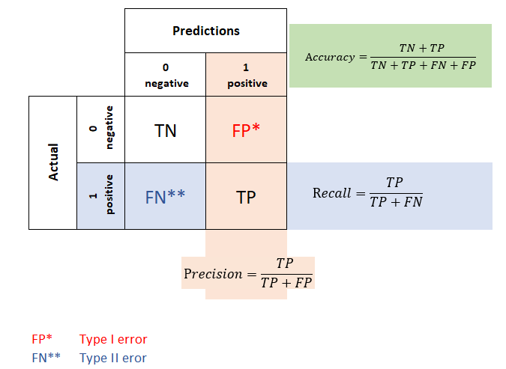
Confusion Matrix

Slide 3
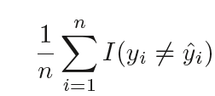
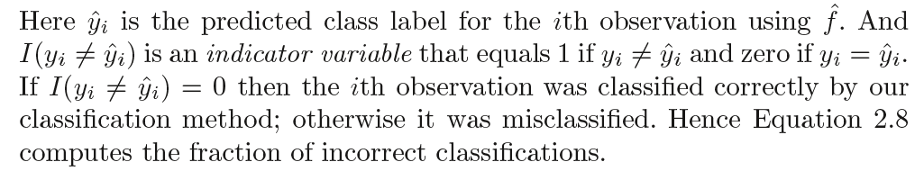

The Classification Setting
The most common approach for quantifying the accuracy our estimate $\hat{f}$ is the training error rate:
The proportion of mistakes that are made if we apply our estimate $\hat{f}$ to the training observations
above

Slide 4
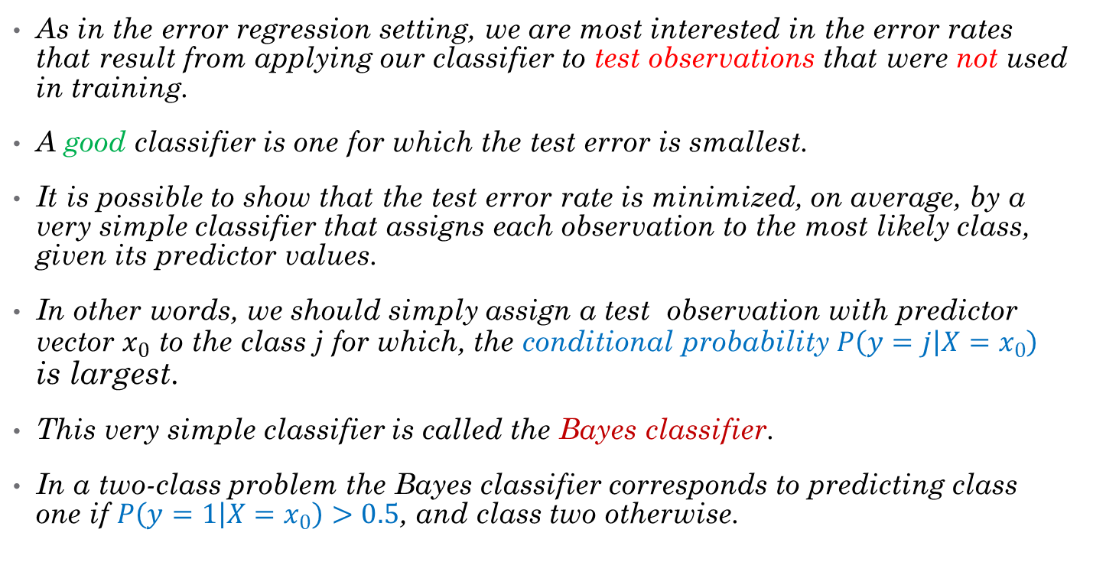
The Classification Setting
As in the error regression setting, we are most interested in the error rates that result from applying our classifier to test observations that were not used in training.
A good classifier is one for which the test error is smallest.
It is possible to show that the test error rate is minimized, on average, by a very simple classifier that assigns each observation to the most likely class, given its predictor values.
In other words, we should simply assign a test observation with predictor vector $x_{0}$ to the class j for which, the conditional probability $P\left(y=j | X=x_{0}\right)$ is largest.
This very simple classifier is called the Bayes classifier.
In a two-class problem the Bayes classifier corresponds to predicting class one if $P\left(y=1 | X=x_{0}\right)>0.5$, and class two otherwise.

Slide 5
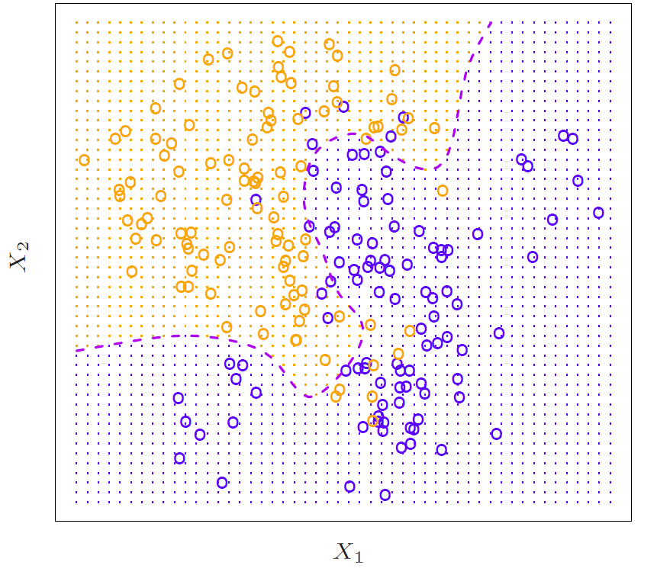
Bayes classifier in two dimensions
A simulated data set consisting of 100 observations in each of two groups, indicated in blue and in orange.
The purple dashed line represents the Bayes decision boundary.
The orange background grid indicates the region in which a test observation will be assigned to the orange class, and
the blue background grid indicates the region in which a test observation will be assigned to the blue class.
Notes:
Imagine the conditional probability is observed.
The purple dashed line represents the points where the probability is exactly 50%. This is called the Bayes decision boundary.
The Bayes classifier produces the lowest possible test error rate, called the Bayes error rate. Since the Bayes classifier will always choose the class for which $P\left(y=j | X=x_{0}\right)$ is largest, the overall Bayes error rate is given by
$$1−E\left\{\max{P\left(y=j | X=x_{0}\right)}\right\}$$
For our simulated data, the Bayes error rate is 0.1304. The Bayes error rate is analogous to the irreducible error, discussed earlier.

Slide 6
K-Nearest Neighbors
In theory we would always like to predict qualitative responses using the Bayes classifier
In practice we do not know the conditional distribution of Y given X, and so computing the Bayes classifier is impossible.
Therefore, the Bayes classifier serves as an unattainable gold standard against which to compare other methods.
Many approaches attempt to estimate the conditional distribution of Y given X, and then classify a given observation to the class with highest estimated probability. One such method is the K-nearest neighbors (KNN) classifier.

Slide 7

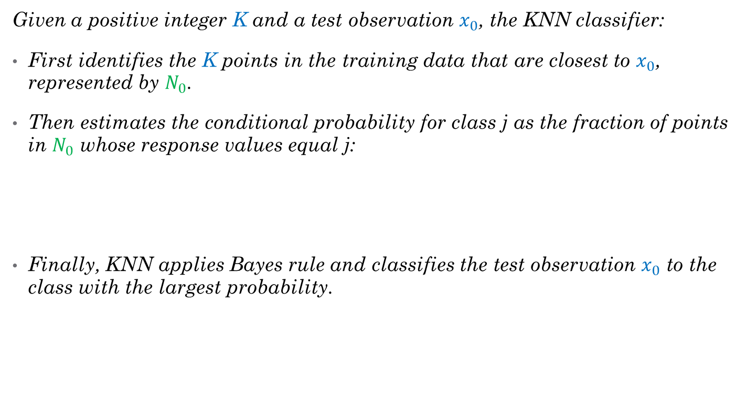
K-Nearest Neighbors
Given a positive integer K and a test observation $x_{0}$, the KNN classifier:
First identifies the K points in the training data that are closest to $x_{0}$, represented by $N_{0}$.
Then estimates the conditional probability for class j as the fraction of points in $N_{0}$ whose response values equal j:
Finally, KNN applies Bayes rule and classifies the test observation $x_{0}$ to the class with the largest probability.

Slide 8
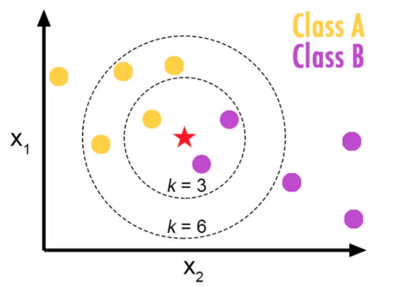
K-Nearest Neighbors
Pros
Simple
Works with any number of classes
Few parameters (K, distance metric)
Cons
Curse of dimensionality
Not good for categorical features
Notes:
The circles are Euclidian distance : https://en.wikipedia.org/wiki/Euclidean_distance
|| p – q ||
Curse of dimensionality : This decrease in performance as the dimension increases is a common problem for KNN, and results from the fact that in higher dimensions there is effectively a reduction in sample size.
spreading 100 observations over p = 20 dimensions results in a phenomenon in which a given observation has no nearby neighbors—this is the so-called curse of dimensionality. That is, the K observations that are nearest to a given test observation x0 may be very far away from x0 in p-dimensional space when p is large, leading to a very poor prediction of f(x0) and hence a poor KNN fit

Slide 9
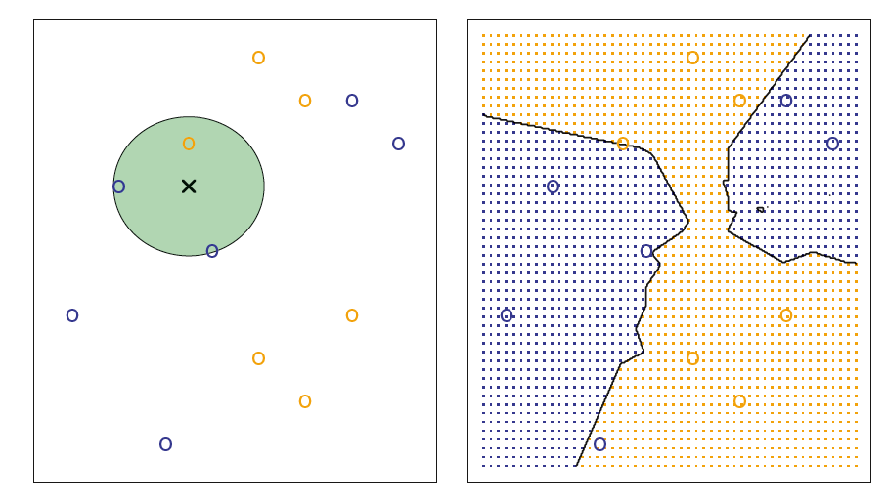
K-Nearest Neighbors
The KNN approach, using K = 3, is illustrated in a simple situation with six blue observations and six orange observations.
A test observation at which a predicted class label is desired is shown as a black cross. The three closest points to the test observation are identified, and it is predicted that the test observation belongs to the most commonly-occurring class, in this case blue.
The KNN decision boundary for this example is shown in black. The blue grid indicates the region in which a test observation will be assigned to the blue class, and the orange grid indicates the region in which it will be assigned to the orange class.
Notes:
In the right-hand panel of Figure 2.14 we have applied the KNN approach with K = 3 at all of the possible values for X1 and X2, and have drawn in the corresponding KNN decision boundary. Despite the fact that it is a very simple approach, KNN can often produce classifiers that are surprisingly close to the optimal Bayes classifier.

Slide 10
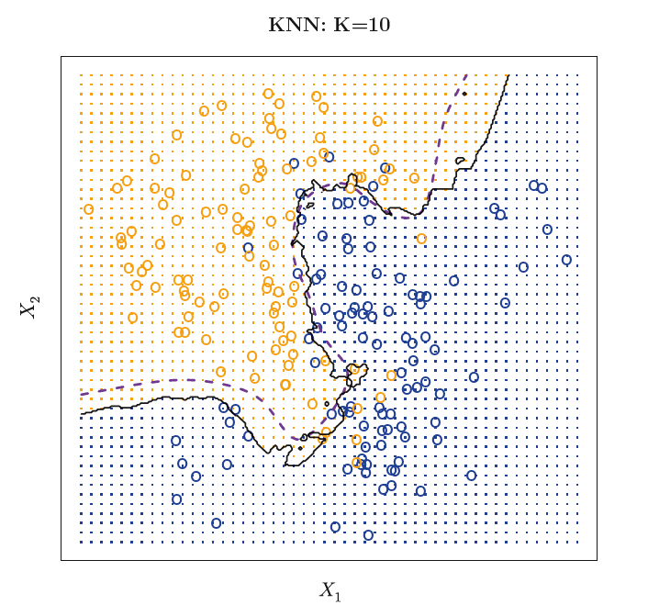
K-Nearest Neighbors
The black curve indicates the KNN decision boundary on the data using
K = 10.
The Bayes decision boundary is shown as a purple dashed line.
Despite the fact that KNN is a very simple approach, it can often produce classifiers that are surprisingly close to the optimal Bayes classifier.
The test error rate using KNN is 0.1363, which is close to the Bayes error rate of 0.1304.
Notes:
Notice that even though the true distribution is not known by the KNN classifier, the KNN decision boundary is very close to that of the Bayes classifier. The test error rate using KNN is 0.1363, which is close to the Bayes error rate of 0.1304.

Slide 11
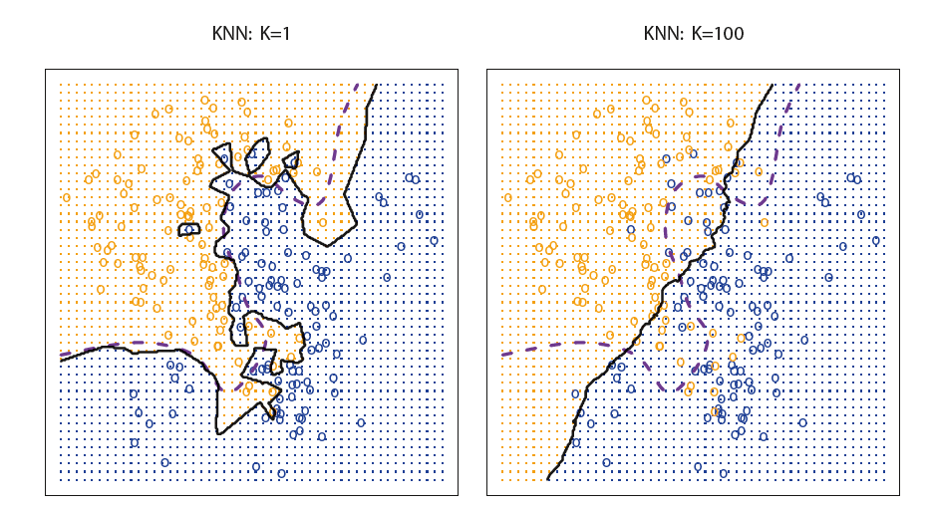
Choice of K
The choice of K has a drastic effect on the KNN classifier obtained.
What can you say about the bias variance trade off and the flexibility of the model?
What about the linearity / non-linearity of the classifier (KNN)?
Notes:
When K = 1, the decision boundary is overly flexible and finds patterns in the data that don’t correspond to the Bayes decision boundary. This corresponds to a classifier that has low bias but very high variance. As K grows, the method becomes less flexible and produces a decision boundary that is close to linear. This corresponds to a low-variance but high-bias classifier. On this simulated data set, neither K = 1 nor K = 100 give good predictions: they have test error rates of 0.1695 and 0.1925, respectively.

Slide 12
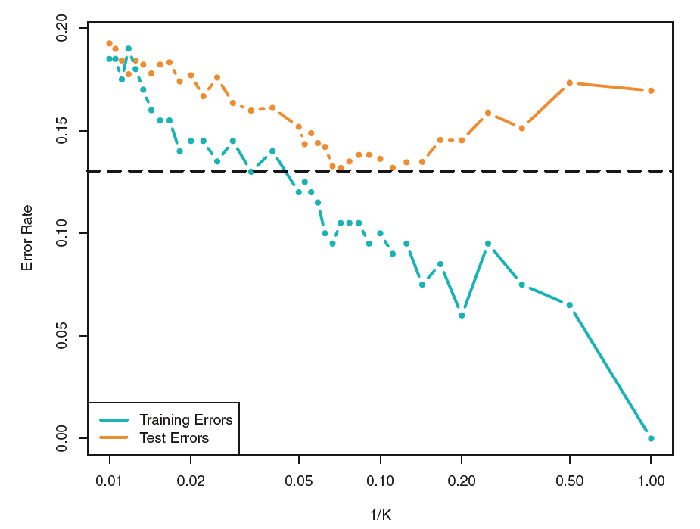
Choice of K
The KNN training / Test error rate shown as the level of flexibility (assessed using 1/K) increases, or equivalently as the number of neighbors K decreases.
The black dashed line indicates the Bayes error rate.
The jumpiness of the curves is due to the small size of the training data set.
Notes:
With K = 1, the KNN training error rate is 0, but the test error rate may be quite high. In general, as we use more flexible classification methods, the training error rate will decline but the test error rate may not.
Just as in the regression setting, there is not a strong relationship between the training error rate and the test error rate. With K = 1, the KNN training error rate is 0, but the test error rate may be quite high. In general, as we use more flexible classification methods, the training error rate will decline but the test error rate may not. In Figure 2.17, we have plotted the KNN test and training errors as a function of 1/K. As 1/K increases, the method becomes more flexible. As in the regression setting, the training error rate consistently declines as the flexibility increases. However, the test error exhibits a characteristic U-shape, declining at first (with a minimum at approximately K = 10) before increasing again when the method becomes excessively flexible and overfits.

Slide 13
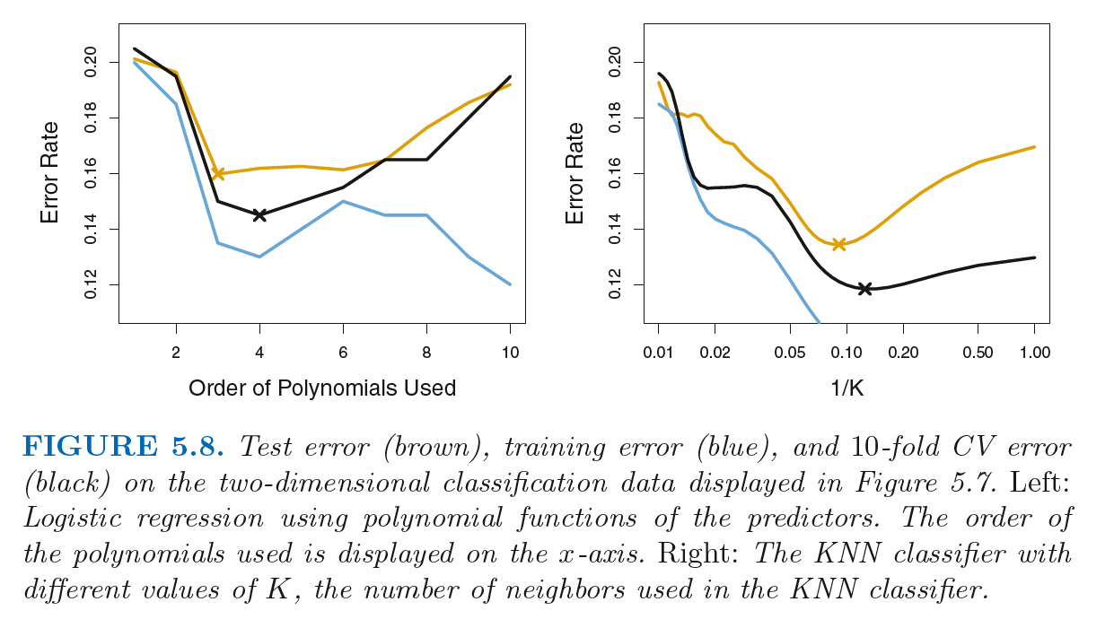
Optimal level of K by using cross validation
Notes:
The 10-fold CV error rate provides a pretty good approximation to the test error rate. While it somewhat underestimates the error rate, it reaches a minimum when fourth-order polynomials are used, which is very close to the minimum of the test curve, which occurs when third-order polynomials are used. In fact, using fourth-order polynomials would likely lead to good test set performance, as the true test error rate is approximately the same for third, fourth, fifth, and sixth-order polynomials.
The right-hand panel of Figure 5.8 displays the same three curves using the KNN approach for classification, as a function of the value of K (which in this context indicates the number of neighbors used in the KNN classifier, rather than the number of CV folds used). Again the training error rate declines as the method becomes more flexible, and so we see that the training error rate cannot be used to select the optimal value for K. Though the cross-validation error curve slightly underestimates the test error rate, it takes on a minimum very close to the best value for K.

Slide 14
